Slide 1

Notes:
Talking points MUST cover:
This year’s Finastra internal hackathon will now, for the first time, open up to external developers all over the world
The hackathon will run VIRTUALLY from November until December 5th.
The onsite City Hacks will run December 3-5th
Thank you to all who submitted their hackathon brand names - Karim El Mourabet from the Global Services team in Dubai – came up with the winning name, Hack to the Future.

Slide 2
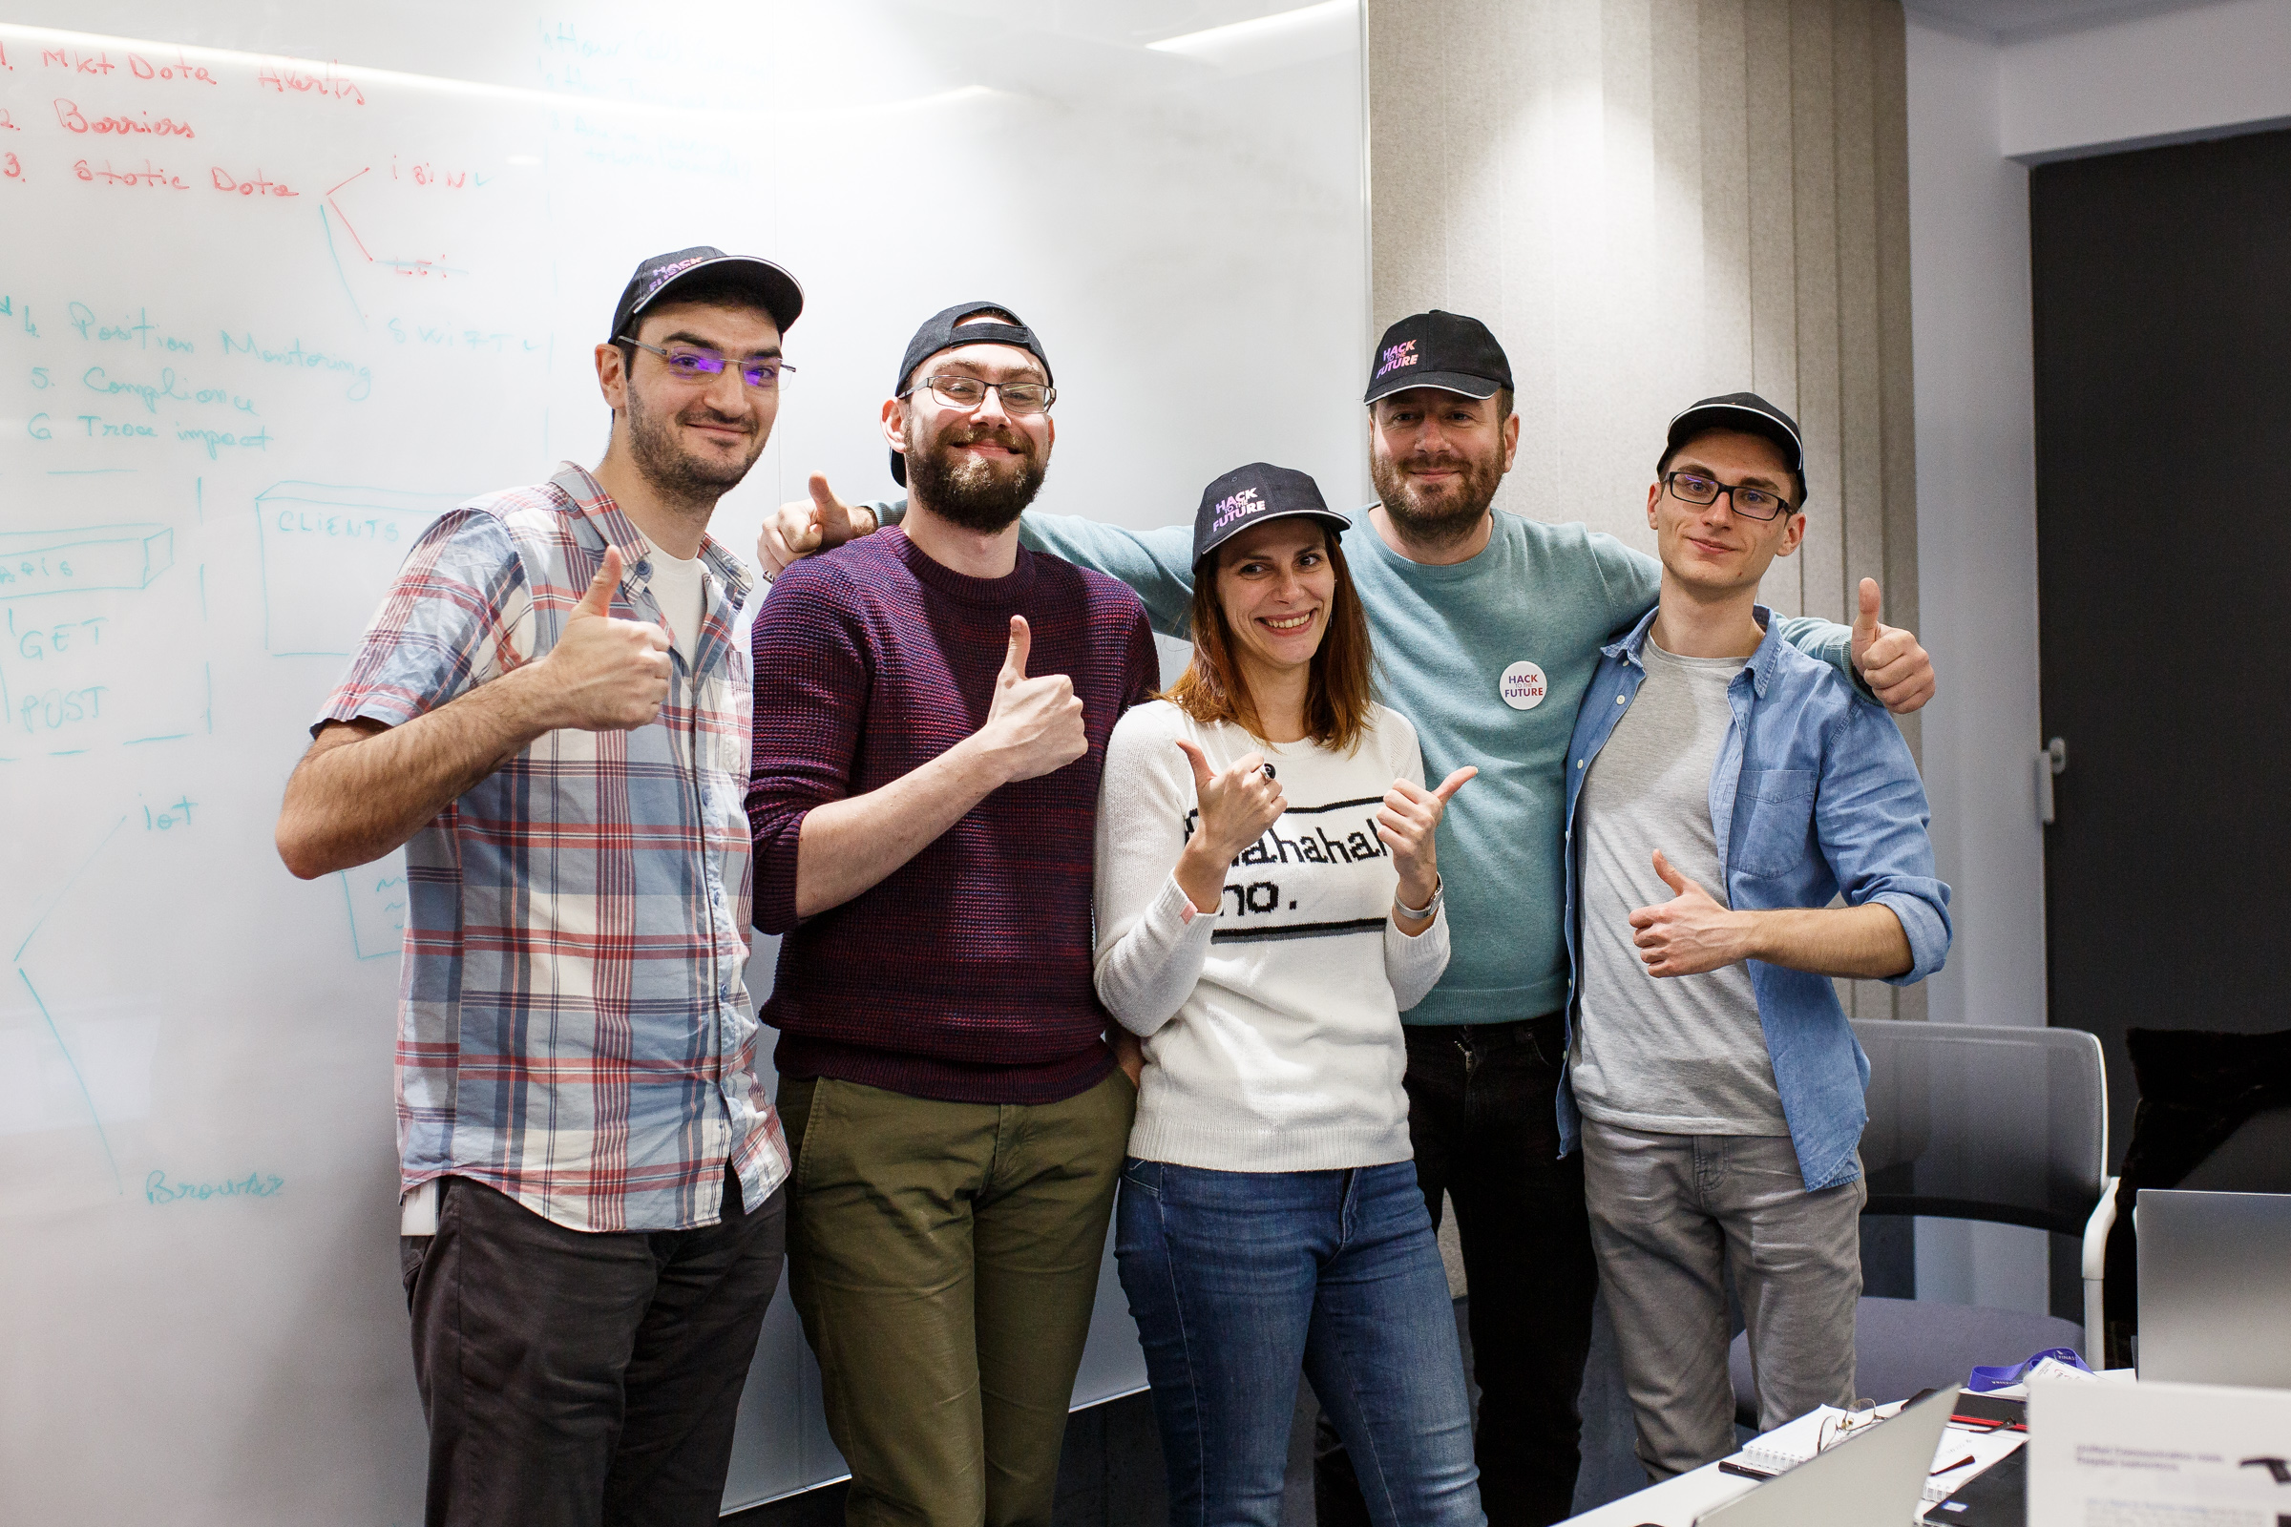
5A Team
Yes! We have a Lady in the Team!

Slide 3
The power of your core is as strong as that of the data you feed it!

Slide 4
PROBLEM
Data needs proper monitoring, integrity, consistency, correctness, completeness & up-to-dateness
Alerting is needed for prompt responsiveness, sharp decision-making, time & cost reduction
Sharp data
5$
48h
Cost per incorrect swift message (HSBC)
Average delays caused by human errors
Reduce costs
Improve operations
Reduce delays
2M$
Average cost of downtime (Swift Systems)
62.4M$
Average human error costs (as per DTCC)
Priceless
Making trading decisions based on accurate data
Responsiveness in high volatility situations

Slide 5


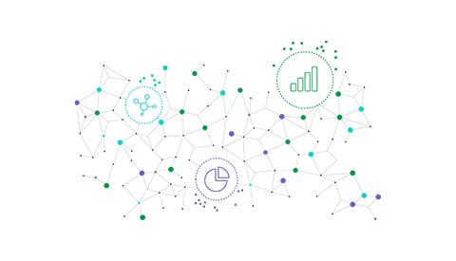
REQUIREMENTS
The power of your core is as strong as that of the data you feed it with!
1
2
3
Verify Interfaces
Monitor Statics
Investigate
Make sure data flows in correctly & consistently in your core
All your statics are properly setup to avoid swift & regulatory exceptions
Track & understand the impact of the alert in your portfolio

Slide 6


Solution
The monitoring app for
Front-officers
Middle-officers
Back-officers
02
Compliance
04
Position and P&L
01
Market Data
03
Static Data

Slide 7
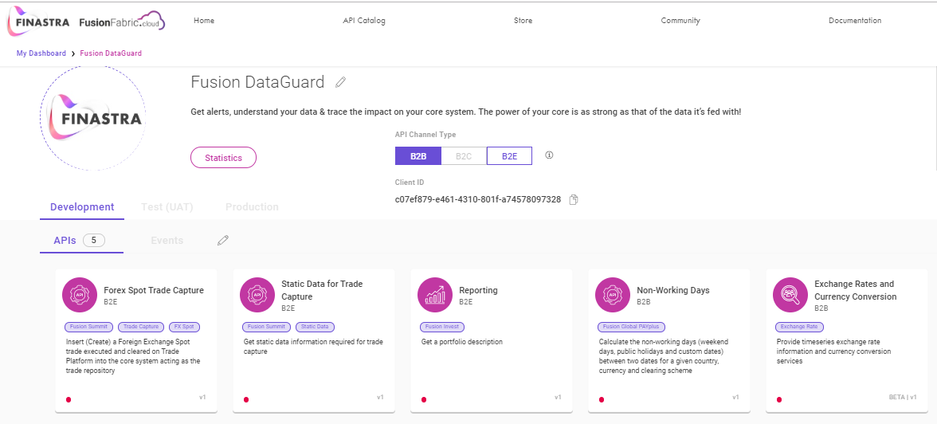
APIs used
Solutions
Treasury & Capital Markets
Payments

Slide 8
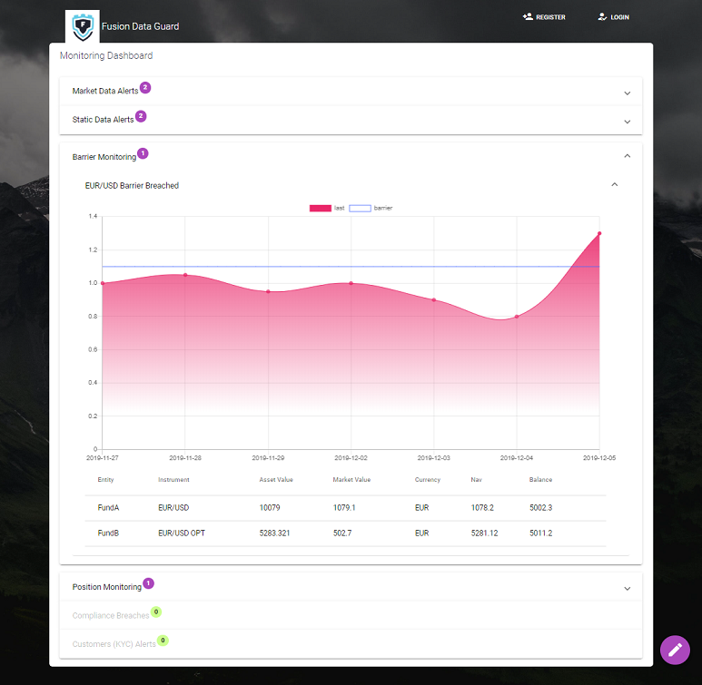



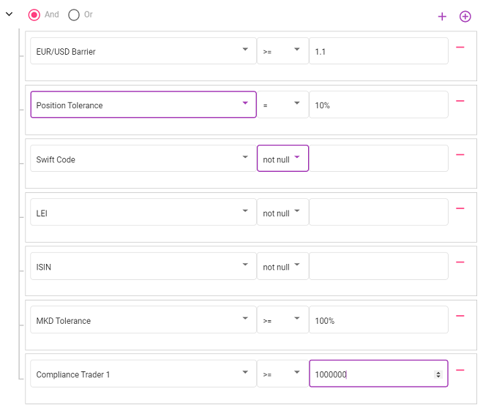
Demo
Real-time Alerts
Fusion DATAGUARD
Get Notified on iDevices
Visually Impaired Support
Understand the Data

Slide 9



From the past to the future
Items | Roadmap |  | Status % | Target % | Business SOM
 | Past | Future
Existing |  |  | 55% | 100% | Current
4 Types of Alerts avail. |  |  | 67% | 90% | Existing TCM clients on supported OAPI versions
Expand App feat. |  |  | 10% | 100% | Appeal to upgrading for leveraging state of the art features
Include Usage of Trades API |  |  | tba | tba | Deliver Compliance as an App All Users of Compliance Services
Expand usage to other APIs |  |  | tba | tba | Address Clients of other Core Solutions
Heterogenous APIs and solutions in each core system
Port existing checks from core to Fusion DataGuard on OpenFin UI – 6M
Unleash Advanced Rule Engine & KYC Services using AI/ML + Sentiment Analysis – 1Y

Slide 10
THANK YOU!
https://fintech.devpost.com/
Notes:
Talking points MUST cover:
This year’s Finastra internal hackathon will now, for the first time, open up to external developers all over the world
The hackathon will run VIRTUALLY from November until December 5th.
The onsite City Hacks will run December 3-5th
Thank you to all who submitted their hackathon brand names - Karim El Mourabet from the Global Services team in Dubai – came up with the winning name, Hack to the Future.

